Slide 1
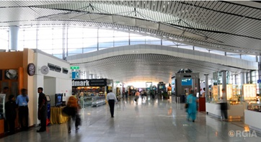
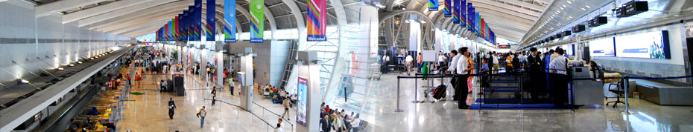
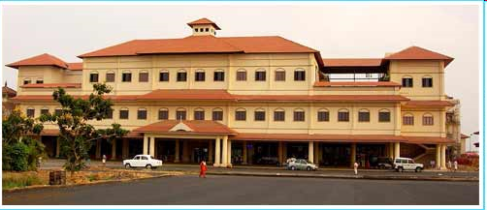
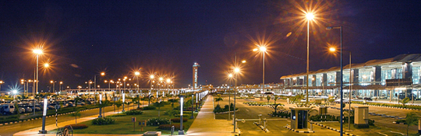
Airports Economic Regulatory Authority of India
.

Slide 2
INTRODUCTION
Airports public sector monopoly till 2003.
Unprecedented growth in air traffic led to considerable strain on airport infrastructure (2004-05 to 2007-08)
  30% groowth in domestic traffic and 15% in international
  2000-2010: Indian aviation had to cope with an additional 84m PAX.
Need for attracting private investment to create world class infrastructure:
  -Govt permitted private sector in airport development in 2003-04.
  -In 2006, Delhi and Mumbai Airports leased out to GMR Group and GVK Group respectively. JVCs were formed.

Slide 3
INTRODUCTION
(Contd…)
OMDA and State Support Agreement (SSA) were signed with JVCs
SSA indicated Govt intention to establish independent regulator
AERA Act, 2008 was enacted for economic regulation of airports with effect from 1.1.2009.

Slide 4
INTRODUCTION
(Contd…)
AERA Act applies to all major airports other than airports and airfields belonging to or subject to control of the Armed forces or paramilitary forces of the Union.
A major airport which handles or is designed to handle more than 1.5mln passengers in ayear
Govt may notify any airport as a major airport
There are 24 major airports as on 1.1.2017

Slide 5

Organizational Structure
Chairperson
Member
Member
Secretary
OSD (Tariff)
Deputy Chief
AGM
(Fin.)
AGM
(Fin.)
Under Secretary (F & A)
Under Secretary (P & A)

Slide 6
Regulatory Objectives
  Facilitating wider policy aims for the aviation sector through regulation of major airports, recognising their role in the sector and economy;
  Protecting and promoting interests of existing and future users of major airports and air navigation services through provision of quality services commensurate with the respective charges, keeping in particular focus the interests of passengers and cargo facility users and the user expectations;
  Promoting investment in airports and air navigation services and their effective management so that all reasonable demands for airport services are met efficiently.

Slide 7
Main Functions of AERA
Determine tariffs for the aeronautical services.
Determine amount of Development Fees.
Determine amount of Passenger Service Fee.
Monitor the set performance standards relating to quality, continuity and reliability of the service at the airport.

Slide 8
Aeronautical Services and AERA’s Approach To Economic Regulation
Aeronautical Services are as given below:
  Services provided by the airport operators (Airport Services)
  Air Navigation Services (ANS) AAI
  Cargo Facility, Ground Handling & Supply of Fuel to an aircraft
Regulatory approach for tariff determination:
Price cap Model
Light touch approach

Slide 9
Airport Charges
Airline charges
  Landing, Parking, Housing Charges.
  Navigation charges (RNFC, TNLC)
Passenger charges
  UDF
  ADF
Cargo Charges
Fuel Supply
Ground Handling

Slide 10
Factors affecting tariff determination
Capital expenditure incurred and timely investment in improvement of airport facilities;
Services provided, its quality and other relevant factors;
Cost for improving efficiency;
Economic and viable operation of major airports;
Revenue received from services other than the aeronautical services;
Concession offered by the Central Government in any agreement or memorandum of understanding or otherwise;
Any other factor which may be relevant for the purposes of this Act.

Slide 11
Procedure to Determine Tariffs
Determine tariff once in five years
  - Amend in public interest during the said period of five years
Transparent process
  - Consultation with stakeholders.
  -stakeholders make submissions to AERA
  -all decisions of AERA fully transparent, documented & explained.
Airport operators, Indian registered airlines, representative bodies of the airlines and airports, Cargo facility user, Central Government, respective State Governments and consumer organizations consulted on a regular basis by the Authority.

Slide 12
Regulatory Building Block Approach
Price Cap Regulation | Single Till
CAPEX
Fair Rate of Return: WACC
RETURN ON RAB
REGULATORY ASSET BASE (RAB)
OPEX+TAX
Non-aero revenue
Revenue Requirement
Traffic
DEPRECIATION
Aeronautical Yield per Passenger
Service Quality
Annual Tariff Proposals

Slide 13
Appeal Process
First Appeal: AERA Appellate Tribunal
Second appeal: Supreme Court

Slide 14
Regulatory Asset Base
Consists of only aeronautical assets.
Common area in Terminal building is classified into aeronautical, non aeronautical.
Normative cost prescribed for runway, apron and terminal building

Slide 15
DEPRECIATION
Companies Act rates are followed for standard assets
Runway, Apron and Taxiways AERA will prescribe based on a study

Slide 16
Weighted Average Cost of Capital
Cost of Equity 16% Study by NIPFP
Cost of debt
Normative debt equity not prescribed

Slide 17
Operation and Maintenance Expenditure
Efficient O&M Expenses to be included
O&M Expre to be allocated- aero & non-aero based on certain criteria

Slide 18
Non Aeronautical Revenue
Major non-aero revenues
Duty free
Retail
Food & Beverages
Car park
Advertisements

Slide 19
TILL
Single Till- All non-aero revenues used to subsidise aeronautical charges:
Dual Till - Non-aero revenues not taken into consideration
Hybrid Till- Portion of non-aero revenues taken as subsidy

Slide 20
Taxation
Taxes paid on aeronautical revenue are returned to the airport operator.

Slide 21
Annual Revenue Requirement
ARR= RAB*WACC+D+O+T-NAR
RAB-Regulatory Asset Base, WACC- Weighted Average Cost of Capital, D-Depreciation, O- O&M Expre, T- Tax
and NAR is Non-Aero Revenue

Slide 22
X Factor
PV of five years ARR is equated to the PV of expected revenue at the current airport charges to arrive at the X Factor.

Slide 23
Yield Per Passenger
Maximum Allowable Yield per Passenger
PV of Aggregate ARR divided by estimated passenger throughput.

Slide 24
Tariff Card
Airport Operator submits tariff card.
AERA checks to see that tariff as proposed earns the operator a sum equivalent to the ARR

Slide 25
CGF and Light Touch Regulation
Cargo, Ground Handling and Fuel Farm Operations
Fixed on light touch if the service is
not material, or if material it is competitive and if material and not competitive, based on User agreements

Slide 26
Recent Developments
National Civil Aviation Policy-2016(NCAP-2016)-The NCAP-2016 has been approved by the Govt.
Para 12(C) of the NCAP-2016 has envisaged changed in the till regime from “Single Till” to “Hybrid Till” . Under Hybrid Till 30% of the Non-aeronautical Revenue shall be used to cross subsidize the aeronautical tariffs .
Para 19(a) of the NCAP-2016 has recommended for minimum 3 ground handlers instead of 2 as the criteria for competition assessment .
Normative Approach: AERA has issued Order No. 07/2016-17 dated 13.06.2016 benchmarking the cost for terminal building, runway, taxiway etc.

Slide 28
Thank you

Slide 29
Orders Issued
7299022357

