Slide 1
TELECOM REGULATORY AUTHORITY OF INDIA
Telecom Sector Reforms
Sanjeev Banzal
Advisor(Networks, Spectrum and Licensing)
TRAI
1st December,2015

Slide 2
India Telecom……Highlights
Fastest Growing Market in the World
Second Highest Number of mobile Subscribers
Total Telephone Subscribers >1Billion
Addition of 10 million subs. Per month
Most of the growth has been in the last decade

Slide 3
INDIAN TELECOM SECTOR- SNAPSHOT (As on 30th Sept,2015)
Number of service areas : 22
Total No. of subscribers : 1,022.61 Million
Wireless subscribers : 996.66 Million
Wireline subscribers : 25.95 Million
Teledensity (overall) : 81
Subscribers availed MNP : 176.39 Million
No. of internet subscribers : 340 Million
Broadband subscribers : 120.88 Million
Gross revenue (for QE Jun-15) : 65030 Crore (Rs)
Monthly ARPU : 120 (Rs)

Slide 4
INDIAN BROADCAST SECTOR- SNAPSHOT
Total House holds : 270Million
TV Households : 169 Million
Registered Channels : 826
(Pvt TV Channels)
Pay Channels : 251
FM Radio Stations : 243
Cable Operators : 70000
DTH Operators : 7
Active DTH subscribers: ~40million

Slide 5
growth drivers
Competition
Favourable demographic outlook
Political stability
Restriction removal on FDI
Distinction achieved
World's lowest call rates (per second billing
World's cheapest mobile handset (USD 6)
Fastest sale of 26.5 million smart phones per quarter.
Sale of 53million mobile phones per quarter

Slide 6
Eventful Journey……Evolution

Slide 7
Contents
Evolution of Telecom Sector in India
Formation of TRAI (1997)
Formation of TDSAT and BSNL (2000)
Reforms in Telecom Licensing
Access service Licensing
Internet Service Licence
National Long Distance (NLD) Licence
International Long Distance (ILD) Licence
National Telecom Policy 2012
Role of TRAI in telecom sector reforms
TRAI’s key recommendations to the Government
Key recent initiatives of the Government

Slide 8
Licensed Service Area Concept
22 Licensed Service Areas/Circle
Metro : 3 (DL,MU,Kol)
‘A’ : 5 (AP, Guj, KTK,MH, TN)
‘B’ : 8 (HR, KER, MP, PB, Raj, UP(E),UP(W),WB)
‘C’ : 6 (AS, BR, HP,J&K, NE, OR)
Jammu & Kashmir
Himachal Pradesh
Punjab
UP(W)
North Eastern States
Haryana
Rajasthan
DELHI
UP(E)
Bihar
Gujarat
Madhya Pradesh
West Bengal
Maharashtra
Orissa
KOLKATA
MUMBAI
Andhra Pradesh
Karnataka
METRO Circles
A Circles
Tamil Nadu
B Circles
Kerala
C Circles

Slide 9
Characteristics of Circles/LSA
‘Circle’ is mostly, but not necessarily, co-terminus with the administrative boundaries of the states.
Exceptions:
Uttar Pradesh(2): UP(E) and UP(W) including Uttarakhand
North-East(1): Six NE States except Assam
Madhya Pradesh: MP & Chhatisgarh
Bihar : Bihar & Jharkhand
AP : AP and Telangana
WB: WB(except Kolkata), Sikkim and A&N
Maharashtra: MH(except Mumbai) and Goa
Kerala : Kerala and Lakshadweep
Delhi: NCR (Delhi, Faridabad,Gurgaon,Gzb, Noida)
Tamilnadu: Earlier TN &Chennai were different;

Slide 10
Evolution of Indian Telecom Sector
Till 1990’s - Government Monopoly
1992 - Private Players permitted in Value Added Services/Cellular
NTP 1994- Entry of Private Players in Basic and Cellular Services(duopoly) :
availability of telephone on demand,
provision of services at reasonable prices,
availability of basic telecom services in all the villages,
export promotion,
FDI attraction and stimulation of domestic investment.

Slide 11
Evolution of Indian Telecom Sector
1994-95 : Licenses were given for cellular mobile services
1997-98: Licenses were given for basic/landline services
Entry of Private Sector necessitated independent regulation and appropriate dispute settlement mechanism
1997 - TRAI Act enacted in establishment of TRAI
NTP’99 : Highlights:
Migration from Fixed to Revenue share regime.
Introduction of multipoly from duo-poly
Dual charge regime wherein the Cellular Mobile Service Provider (CMSPs) would be required to pay a one-time entry fee and a license fee based on a revenue share
Introduced Government operators(BSNL/MTNL) as third operator

Slide 12
Evolution of Indian Telecom Sector
2000- Regulatory Functions and Adjudicatory Functions including dispute settlement separated, TDSAT established through amendment of TRAI Act.
2000 : Govt separated itself from providing services: BSNL formed
2003 : Introduction of Calling Party Pay(CPP) regime
: Interconnection Usages Charges(IUC) Regulation
: Introduction of Unified Access Service License(UASL)
2004 – Broadcasting sector have been brought under TRAI/TDSAT

Slide 13
Evolution of Indian Telecom Sector
Highlights :
Increase rural teledensity to 70 by the year 2017 and 100 by the year 2020
Achieve 175mn broadband connections by the year 2017 and 600mn by the year 2020 at minimum 2 Mbps download speed and making available higher speeds of at least 100 Mbps on demand
Introduce Unified Licensing and delink spectrum from license
Provide preference to domestically manufactured telecommunication products
Liberalize spectrum by allowing any service in any technology
Make available additional 500 MHz spectrum for IMT services by 2020
Ensure mobile number portability and provide free roaming
Introduce spectrum sharing and spectrum trading
National Telecom Policy-2012

Slide 14
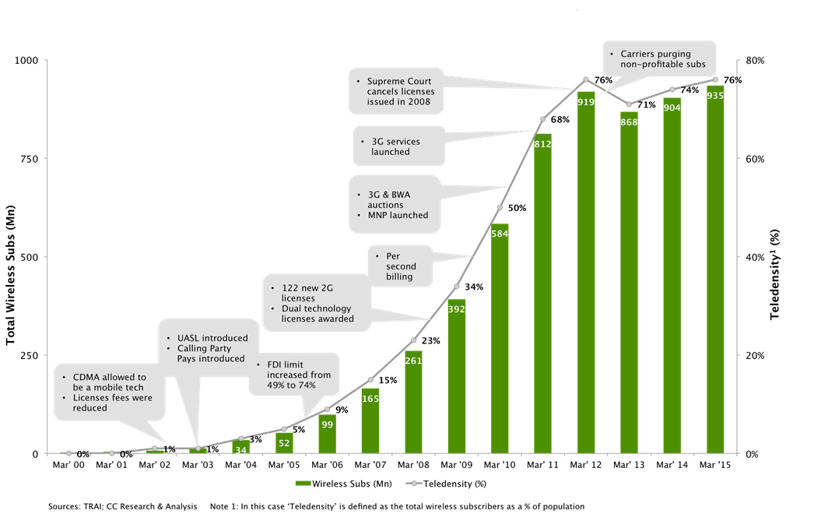
Growth of Indian Mobile Subscribers and Key Milestones (2000-2015)

Slide 15
Revenue in the Telecom Sector

Slide 16
Tariff Vs Teledensity

Slide 17
Development in other Licenses
Internet Service Licence
Internet Service was launched on 15th August 1995 through Videsh Sanchar Nigam Limited (VSNL).
In November 1998, the sector was opened to Private Operators for providing Internet Services.
No Licence Fee and unlimited number of players for delivering Internet service.
Annual licence fee at 6% of Adjusted Gross Revenue (AGR) subject to a minimum of Rs.50,000/- for category ‘A’ and Rs.10,000/- for ‘B’ service areas.
In January 2010, the onetime entry fee was amended to Rs 30 lakh for Category-A & Rs. 15 lakh for Category-B Internet Service License.

Slide 18
Development in other Licenses
National Long Distance (NLD) Licence
National Long Distance Services were opened w.e.f. 13th August 2000 without any restriction on the number of operators.
As per the original provisions of NLD licence, the combined net worth requirement of the company for NLD licence was Rs 2500 crore and Paid up Capital of Rs 250 crore was required. The entry fee was fixed as Rs 100 crore and the annual licence fee was fixed as 15% of AGR.
From 1st January 2006, the licensee was required to pay one-time non refundable Entry Fee of Rs 2.5 crore, an annual licence fee of 6% of AGR. The networth requirement and paid up capital requirement of the company was also reduced to Rs 2.5 crore.
License fee in 2013 was increased to 8% of AGR

Slide 19
Development in other Licenses
International Long Distance (ILD) Licence
International Long Distance Service opened from 1st April 2002 for private operators.
As per the original provisions of ILD licence, the combined Net worth requirement of the company for ILD licence was Rs 25 crore. The entry fee was fixed as Rs 25 crore and the annual licence fee was fixed as 15% of AGR.
From 1st January, 2006 these provisions were relaxed and the licensee was required to pay one time Entry Fee of Rs 2.50 crore and an annual licence fee of 6% of AGR. Net worth and Paid up Capital of the company for ILD service licence was reduced to Rs. 2.5 crore.
License fee in 2013 was increased to 8% of AGR

Slide 20
Unified License (UL)
One company can have only one UL.
There can be authorization for any one or more services. Depending upon the authorization, the scope and jurisdiction of the licence will vary.
The allocation of spectrum is delinked from the licence and has to be obtained separately through auctions.
License fee made uniform to 8% of AGR

Slide 21
Authorization For Different Services Under Unified License
Sl. No. | Authorization | Jurisdiction
1 | Unified license (All Services) | All India jurisdiction
2 | Access Service | Service Area wise
3. | Internet Service : Cat-A | All India jurisdiction
4. | Internet Service : Cat-B | Service Area wise
5. | Internet Service : Cat-C | Secondary Switching Area wise
6. | National Long Distance (NLD) | All India jurisdiction
7. | International Long Distance (ILD) | All India jurisdiction
8. | Global Mobile Personal Communication by Satellite (GMPCS) Service | All India jurisdiction
9. | Public Mobile Radio Trunk (PMRTS) Service | Service Area wise
10. | Very Small Aperture Terminal (VSAT) Closed User Group (CUG) Service | All India jurisdiction
11. | INSAT MSS-Reporting (MSS-R) Service | All India jurisdiction
12. | Resale of International Private Leased Circuit (IPLC) Service | All India jurisdiction

Slide 22
Development in Spectrum Usages Charges
Spectrum Usages Charges as %of AGR
Amount of spectrum (MHz) | Upto 31.03.2010 | From 01.04.2010 | Spectrum obtained from Auction 2014 | For licensees having administrative and auctioned spectrum
Upto 2 x 4.4/ 2 x 2.5 | 2 | 3 | 5% (for any holding) | Weighted Average of existing slab and holding in 5% slab
Upto2 x 6.2 | 3 | 4
Upto 2 x 8 | 4 | 5
Upto 2 x 10 | 4 | 6
Upto 2 x 12.5 | 5 | 7
Upto 2 x 15 | 6 | 8
Beyond 2 x 15 |  | 9

Slide 23
Role of TRAI in Telecom Sector Reforms

Slide 24
Regulatory Framework in India
Agencies involved
Licensor:- Granting of Licenses
TRAI :- Recommendations and Regulations
HC/TDSAT :- Appellate & Adjudication
Supreme Court :- Final Appellate Authority

Slide 25
Regulators of the Sectors
TRAI
Telecom
Cable
&
Broadcasting
Ministry of Communications & IT
Ministry of Information & Broadcasting

Slide 26
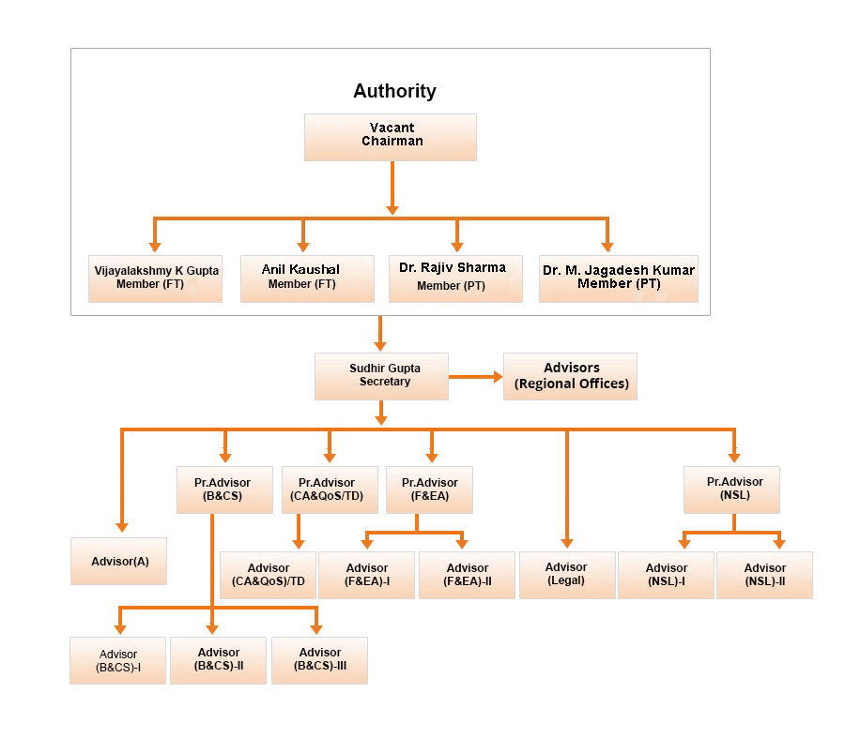
ORGANISATION CHART
Chairman
Member
(Whole-time)
Member
(Whole-time)
Member
(Part-Time)
Member
(Part-Time)
Secretary

Slide 27
TRAI’s Areas of Concern
Consumer Protection
Quality of Service
Affordable Tariff
Interconnection
Regulations, Directions, Orders
Recommendations

Slide 28
TRAI - MISSION
To ensure that the interests of consumers are protected and nurture conditions for growth of, telecommunications broadcasting and cable services in a manner and at a pace which will enable India to play a leading role in the emerging global information society.
To achieve above, the Authority follows a consultation process in the discharge of its functions:
TRAI interacts with various stakeholders
Holds ‘Open House Meetings’ for having interactive
sessions with stakeholders and experts
The participative and explanatory process adopted by TRAI leads to transparency in policy making and has received wide acclaimation.

Slide 29
TRAI - GOALS AND OBJECTIVES
Providing a regulatory regime that facilitates achievements of the objective of New Telecom Policy
Increase in the tele-density and access to Telecommunication at affordable price.
Transparency in decision making by affording an opportunity to all stakeholders
Adoption of emerging technologies within the framework of a technology neutral policy.

Slide 30
TRAI - GOALS AND OBJECTIVES
Promoting level playing field and competition amongst Service Providers
Making available telecom services which in terms of range, price & quality are comparable to the best in the world.
Rebalancing tariffs to achieve objectives of affordability
Protecting the interest of consumers
Monitoring the quality of service

Slide 31
TRAI’s Power & Functions
Recommendatory
Licensing related issues
Measures to facilitate competition and growth
Issues related to increase n efficiency of telecom operations
Efficient management of available Spectrum
Regulatory Functions
Interconnection
Tariff Fixation of the Services
Quality of Service
Issue orders/Directions to the Service Providers on matters relating to its Regulatory Functions

Slide 32
Regulatory Approach
Focus on optimization of network buildup and efficiency of operation
Nurturing of competitive market scenario
Well timed interventions and forbearance of tariff
Initiatives for Infrastructure sharing, VoIP, MVNO, 3G & 4G
Bridging the ‘Digital Divide’
Broadband for Inclusive Growth
Restructuring of Cable TV, Digitalisation, Promotion of CAS, DTH, FM Radio etc

Slide 33
Regulatory Issues addressed
Regulatory
Tool
Box
USO
Comprehensive USO Policy in place
Issues addressed through regulations and directives;
One of the few countries to publish RIO
A comprehensive IUC regime too is in place
Interconnection
Telecom Tariff Order & amendments;
De-regulation of tariffs, starting with cellular tariffs
Monitoring of tariffs for predation
Tariffs
Based on TRAI recommendations, open competition has been introduced in all sectors including unified access.
Internet Telephony introduced
Licensing
Quality of Service
End User Quality of Service regulation,
Publicly available customer survey, MNP
Competition
Accounting separation, RIO by service providers with Significant Market Power, Merger issues MNP
Broadband
Broadband Policy 2004 issued by Govt.
Cable & Broadcasting
Protection of consumers’ Interest

Slide 34
Tariff Issues – Consumers’ Interest
Disclosure of full details of tariffs
Explicit consent of customers for VAS
Full talk time on Top Ups, except administrative fee and applicable taxes.
No migration Charge
Protection against hike in tariffs
key tariff information in vernacular language at all the retail outlets
No change in mobile number when subscriber change tariff plans or move from prepaid to postpaid & vice versa and when moves from one service area to another.
Ceiling for roaming tariffs.

Slide 35
Major Recommendations of TRAI for sectoral reforms
Introduction of competition in ‘National Long Distance Service’ and ‘International Long Distance Service’
Intra-Circle merger and acquisition guidelines
Infrastructure sharing
Mobile Number Portability/Full Number Portability
Promotion of competition in IPLC
Resale in IPLC
Licensing policy for Access Service Provisions
Introduction of Conditional Access System
Auction for spectrum

Slide 36
Latest Recommendations
Spectrum auctions:2012,2013,2014 & 2015
Broadband penetration quickly
Spectrum trading and sharing
Single number based Integrated emergency and communication response system(IECRS)
Priority call routing for the persons involved in the rescue and relief operations during disasters
Telecom planning for NE States, ANI and Lakshadweep islands
Introduction of Virtual Network Operators(VNOs)

Slide 37
Latest Regulations
Mobile Number Portability --Pan India Portability
Telecommunications Commercial Communications Customer Preference Regulations(Do not call registry)
Compensation on cal drops
Financial disincentives for operators for failing to maintain quality of services, wrongful rejection of MNP request

Slide 38
Recent Government Initiatives
Approved the rules for spectrum trading that will allow telecom companies to buy and sell rights to unused spectrum among themselves.
Approved the guidelines on spectrum sharing, aimed to improve spectral efficiency and quality of service
Several initiatives to promote manufacturing in the country, Preferential market access to promote ‘Make in India’
Government plans to roll out free high-speed wi-fi in 2,500 cities and towns across the country over the next three years.

Slide 39
THANK YOU
Sanjeev Banzal
Advisor(Networks, Spectrum and Licensing)
TRAI
Email: sbanzal@gmail.com
www.trai.gov.in

Slide 40
Eligibility conditions under Unified Licensing
Sl No. | Service | Minimum Equity (Rs. Cr.) | Minimum Networth (Rs. Cr.)
1 | UL(All services) | 25 | 25
Service Authorisation wise requirements
1 | Access Service (Telecom Circle / Metro Area) | 2.5 | 2.5
2 | NLD (National Area) | 2.5 | 2.5
3 | ILD (National Area) | 2.5 | 2.5
4 | GMPCS (National Area) | 2.5 | 2.5
5 | Resale IPLC (National Area) | 2.5 | 2.5
6 | Other Authorisations | NIL | NIL

Slide 41
Entry fee under Unified Licensing
Sl No. | Service | Entry Fee (Rs. In Crore)
1 | UL(All services) | 15
Service Authorisation wise requirements
1 | Access Service (Telecom Circle / Metro Area) | 1
 |  | 0.5 for NE/ J&K
2 | NLD (National Area) | 2.5
3 | ILD (National Area) | 2.5
4 | VSAT (National Area) | 0.3
5 | PMRTS (Telecom circle/Metro) | 0.005
6 | GMPCS (National Area) | 1
7 | INSAT MSS-R (National Area) | 0.3
8 | ISP "A" (National Area) | 0.3
9 | ISP "B" (Telecom circle/Metro Area) | 0.02
10 | ISP "C" (SSA) | 0.002
11 | Resale IPLC(National Area) | 1

